Slide 1
Climate Change, Health impact and Bangladesh
Prof. Quazi Tarikul Islam
FCPS, FACP, FRCP(Glasg), FRCP(Edin)
Professor of Medicine
Dhaka Medical College

Slide 2
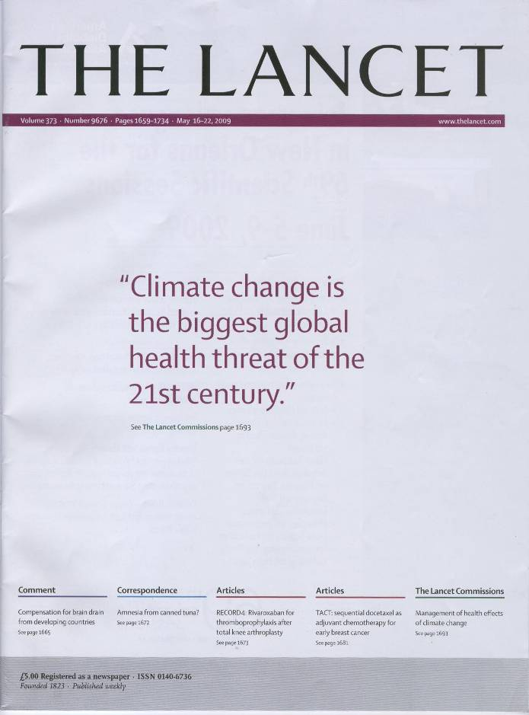
Lancet/UCL Commission, May 2008

Slide 3
Have we yet understood the profound significance of the connection between climate change and human health
?

Slide 4
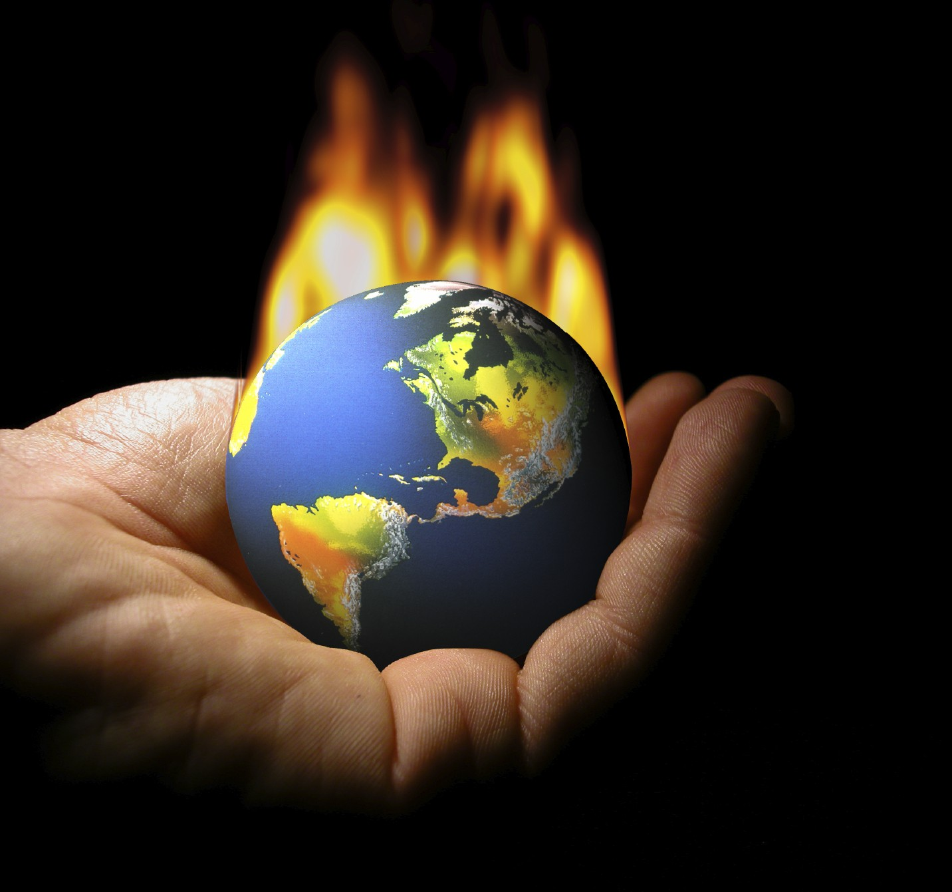

Slide 5
Overview
Introduction
  Definition of climate change
What is happening and who is at risk?
Human Impacts on Climate
  Green House Gasses
  Water pollutions
  Food and Agriculture
  Air pollutions
  Waste disposals
  Infrastructural
Climatic Impact on Human Health
  Bio-diversity
    Water and land
    Air
    Vector
Plan of Management
  Mitigation
  Adaptation
Conclusion

Slide 6
Definition: Environment & Health hazard
World Health Organization (WHO, 1993): defines
"Environmental health comprises those aspects of human health, including quality of life, that are determined by physical, chemical, biologic, social, and psychosocial factors in the environment."
And any external factor that negatively affects your health can be considered an environmental health hazard.

Slide 7
Climate change
In 1969, the Apollo moon shot provided extraordinary photographs of this planet, suspended in space.
This transformed how we thought about the biosphere and its limits.

Slide 8
Climate change
Populations of all animal species depend on supplies of food and water, freedom from excess infectious disease, and the physical safety and comfort conferred by climatic stability.
The world’s climate system is fundamental to this life support.

Slide 9
Climate change
To address climate change, public health should therefore consider risks at the whole population level, informed by an understanding of ecological relations and the imperatives of environmental sustainability.
- The Lancet, Nov, 2009

Slide 10
Climate Change: Basic Issues
Earth’s climate varies naturally – because of a variety of cosmological and geological processes.
“Climate change” refers to an additional, and relatively rapid, change induced by human actions.
The additional change – several degrees C within a century – will disrupt the foundations of life on Earth.
Ecosystems and life in general have evolved within a narrow band of climatic-environmental conditions.

Slide 11
Overview
Introduction
  Definition of climate change
What is happening and who is at risk?
Human Impacts on Climate
  Green House Gasses
  Water pollutions
  Food and Agriculture
  Air pollutions
  Waste disposals
  Infrastructural
Climatic Impact on Human Health
  Bio-diversity
    Water and land
    Air
    Vector
Plan of Management
  Mitigation
  Adaptation
Conclusion

Slide 12
Climate Change is Happening Now
Source: IPCC 2007 (4th Assessment)
Notes:
The 2007 report of the Intergovernmental Panel on Climate Change states that global warming is unequivocal, that it is due to anthropogenic increases in greenhouse gases that are forcing global climate changes including warming, rising sea level, and declining snow cover. Because CO2 and other greenhouse gases have long half-lives in the environment, we are already committed to significant warming in the coming decades even if we were to stop emissions now.

Slide 13
CLIMATE CHANGE IS HAPPENING NOW.
GLOBAL WARMING HAS ACCELERATED IN RECENT YEARS
SEA LEVELS ARE RISING, GLACIERS ARE MELTING AND PRECIPITATION PATTERNS ARE CHANGING
EXTREME WEATHER EVENTS ARE CHANGING IN FREQUENCY AND INTENSITY.

Slide 14
CLIMATE CHANGE IS HAPPENING NOW.
HUMAN ACTIVITIES ARE NOW THOUGHT TO BE THE MAIN CAUSE OF THE CHANGING CLIMATE
CONTINUED WARMING COULD LEAD TO ABRUPT OR IRREVERSIBLE IMPACTS.
HUMAN-INDUCED CLIMATE CHANGE WILL CONTINUE FOR AT LEAST THE NEXT FEW DECADES.

Slide 15
Climate Change is Happening Now
In the last 300 years, the worlds population became 10 times.
Energy used in 30 years (1970-2000) became double.
6 billion people of the world are using 1/3 rd of land for grazing and crops by removing natural vegetation.
De-forestation of 5-6 million hectors of land per year (0.5%) is happening. 60% OF DEFORESTATION OF THIS EARTH HAS OCCERED IN LAST 100 YEARS.

Slide 16
WHO IS AT RISK?
  SMALL ISLANDS
  DEVELOPING STATES
  LOW-LYING REGIONS
THESE ARE IN THE FRONT LINE.
URBAN POPULATIONS, PARTICULARLY THOSE OF TROPICAL MEGA CITIES,13 OF 20 ARE AT COSTAL BELT, EXPOSED TO A COMBINATION OF HEALTH RISKS SUCH AS HEATWAVES, FLOODS, INFECTIOUS DISEASES AND AIR POLLUTION.

Slide 17
WHO IS AT RISK?
MOUNTAIN POPULATIONS ARE AT INCREASED RISK OF WATER INSECURITY, FLOODS LANDSLIDES, AND INFECTIOUS DISEASES.
IN POLAR REGIONS, INDIGENOUS PEOPLE MAY BE PARTICULARLY AFFECTED BY CHANGES IN TEMPERATURE, FOOD SOURCES AND LIVELIHOODS.

Slide 18
Climate change over the ages
Abnormally high temperatures in Europe in the summer of 2003 were associated with at least 27,000 deaths
Climate change was estimated to be responsible in 2000 for approximately 2.4% of worldwide diarrhea, and 6% of malaria in some middle-income countries
Global climate change is, therefore, a newer challenge to ongoing efforts to protect human health

Slide 19
Climate change: gradual change + sudden events
Flooding, windstorms
Vector-borne diseases
Foodborne disease
Waterborne disease
Direct effects of rising temperatures
Changes in air pollution
Ultraviolet radiation
Notes:
Scoping studies:
UKCIP launched in 1997 to help co-ordinate scientific research into the impacts of climate change, and to help organisations adapt to those unavoidable impacts
In order to determine the impacts of climate change, scoping studies have been produced for most regions.
More specifically for the health sector, quantitative estimates of the possible impacts of climate change on health in the

Slide 20
Overview
Introduction
  Definition of climate change
What is happening and who is at risk?
Human Impacts on Climate
  Green House Gasses
  Water pollutions
  Food and Agriculture
  Air pollutions
  Waste disposals
  Infrastructural
Climatic Impact on Human Health
  Bio-diversity
    Water and land
    Air
    Vector
Plan of Management
  Mitigation
  Adaptation
Conclusion

Slide 21
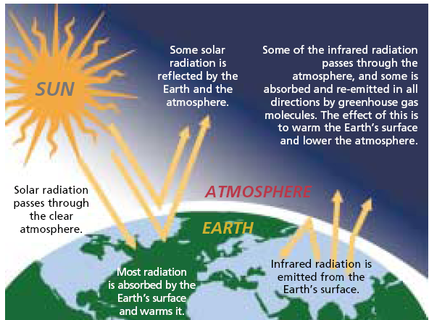

Slide 22
Annual Carbon Dioxide Emissions
Total CO₂ – measured in thousands of metric tons
The most current estimates state that China is about to surpass the US in
emissions and its rate of emissions is accelerating.
Source: U.S. Greenhouse Gas Emissions Inventory

Slide 23
Global addiction to fossil fuel: coal, oil and gas: very cheap, very useful and very dangerous
We have been releasing 350 million years-worth of carbon locked away in fossil fuels in 150 years
150 years
100 years
50 years
NOW
First Oil Well
4000 cars in USA
First commercial jet ticket
600,000,000 cars
4,000,000,000 passenger flights
Notes:
The earth absorbed huge quantities of carbon dioxide into fossil fuel deposits in the carboniferous period – it took about 160 million years within that period to reduce it to levels which support today’s level of life – we have unlocked a significant proportion of this carbon in 160 years.
We have already released well over 500 billion tonnes of carbon into the atmosphere over h. We are set to burn the next 500 billion in 40 years. That will exceed the trillion tonnes carbon budget that will tip us into dangerous climate change (over 2 degrees etc...).
If we limit the emissions to less than a trillion tonnes, then we stand a 25% chance of avoiding dangerous climate change. That means taking significant action at all levels now.
-----------------
In 2003 heatwave, 35,000 people died prematurely in Europe, 2000 of them in London in 10 days – and nobody even realised until several weeks afterwards [I can supply reference]
Health professionals and the NHS are widely respected and trusted
There are many immediate benefits too (“co-benefits”) by changing how we move (active travel) and what we eat (less meat/dairy), and how much attention we pay to e.g. helping our patients improve their home insulation.
-------------------
“Humanity's carbon budget set at one trillion tonnes.” New Scientist, 29 April 2009

Slide 24
196,442 kg of coal…..
103,881,279 litres of gas….
150, 179 litres of oil…..
…….. A SECOND
Notes:
2008 fuel use

Slide 25
Flows of emissions of CO₂ from burning fossil-fuels have risen rapidly since 1950
Billions of tonnes of CO2
Notes:
Half of human greenhouse gas emissions have been since 1973!!! They last a long time, too: 1/5 will still be in the atmosphere, warming us, in 33,000 years time.

Slide 26
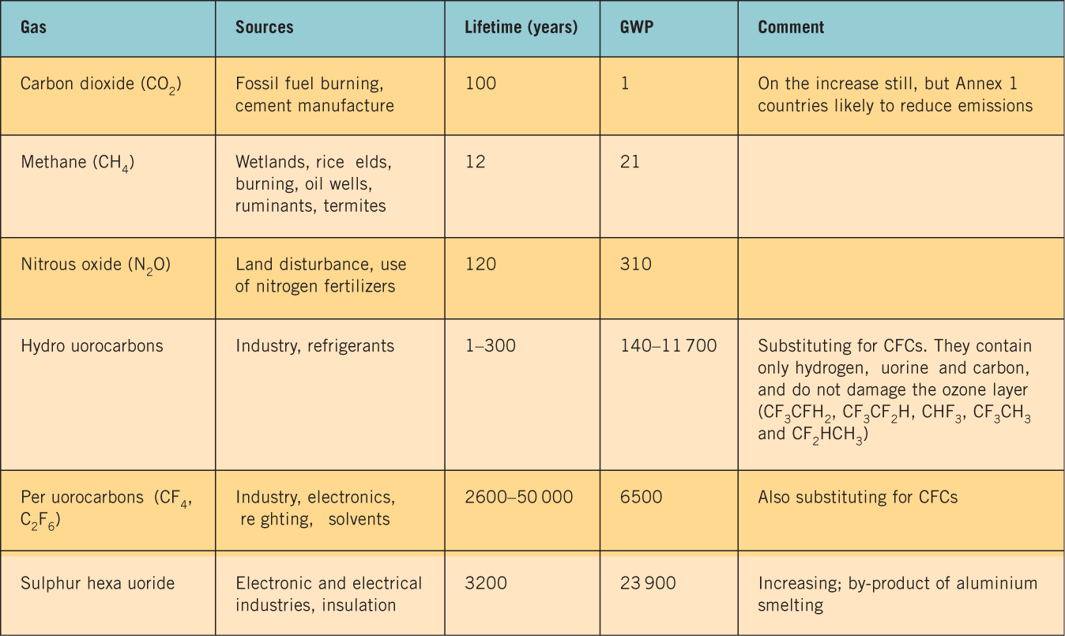
Table 21.4
Notes:
Greenhouse gases in the Kyoto Protocol, lifetime in the atmosphere and global warming potential (GWP) on a scale where co₂=1 (see text for definition).

Slide 27
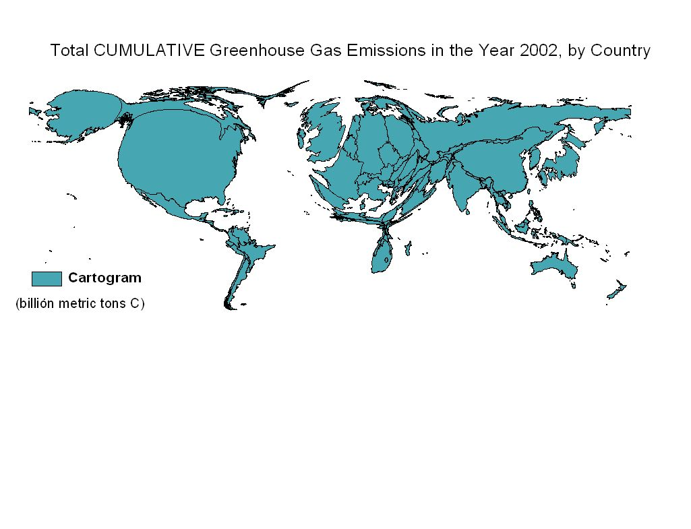
Cumulative CO₂ emissions from fossil fuels
Source: Patz JA, Gibbs HK, Foley JA, Rogers JV, Smith KR, 2007, Climate change and global health: Quantifying a growing ethical crisis. EcoHealth 2007 4; (4): 397–405.
Notes:
Here is the distribution of CO2 emissions from fossil fuel combustion for comparison. Note that th US and Europe, so skinny in the first map, are so fat here. Any Africa and India, so fat in the first and so minimal here. This comparison would change a bit if deforestation and other GHGs are included, but the point remains that the countries causing most of the problem are not those experiencing the problem

Slide 28
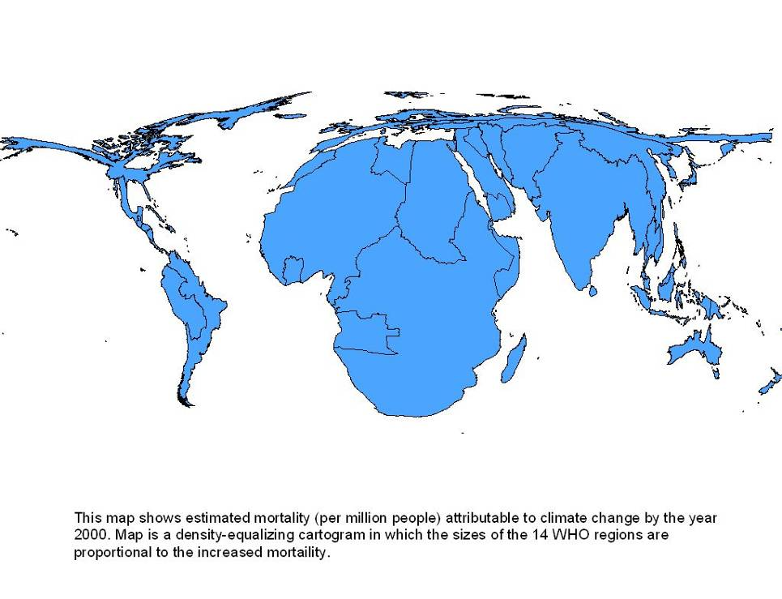
Cartogram of Climate-related Mortality (per million pop) yr. 2000
.
        Source: from the WHO Comparative Risk Assessment, 2004
Notes:
Remember this map showing the inequities for climate change’s health impacts.

Slide 29
Loss of biodiversity
Defined as the number and variety of species in ecological systems
Human activities are causing decline in species numbers (esp land use)
Impossible to know exact number of species but extinctions are generally well-documented
  Since 1600, 490 plants and 580 animals extinct
Why is it important?
  Keystone species – critical role in the ecosystem
  Potential and actual economic importance (genetic pool)
  Any species may be part of a human life-support system
Most species live in the tropics – where most disturbance is now occurring
‘Hotspots’
  Number of species threatened far exceeds our capacity to protect
  Therefore need to concentrate conservation efforts in areas of high diversity
Future – climate change is likely to cause diversity loss from tropical forests

Slide 30

Ice on
Kilimanjaro

Slide 31
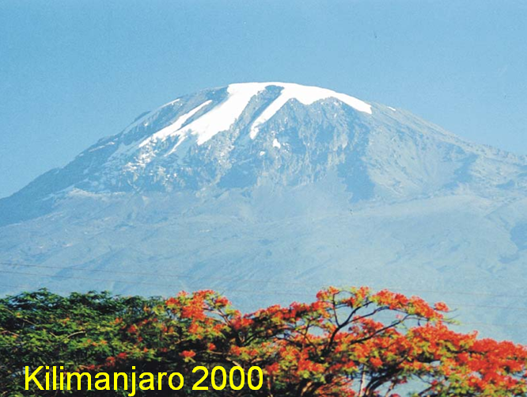
Ice on
Kilimanjaro
)
15
2
10
Area (km
5
0
1900
1920
1940
1960
1980
2000
2020
Year

Slide 32
Water Pollution by Human
Surface water
In urban areas, primarily from industrial and domestic wastes
In rural related pollution areas with co-use of waters for humans and livestock
Drinking water Especially in areas without access to treated/piped water
contamination

Slide 33
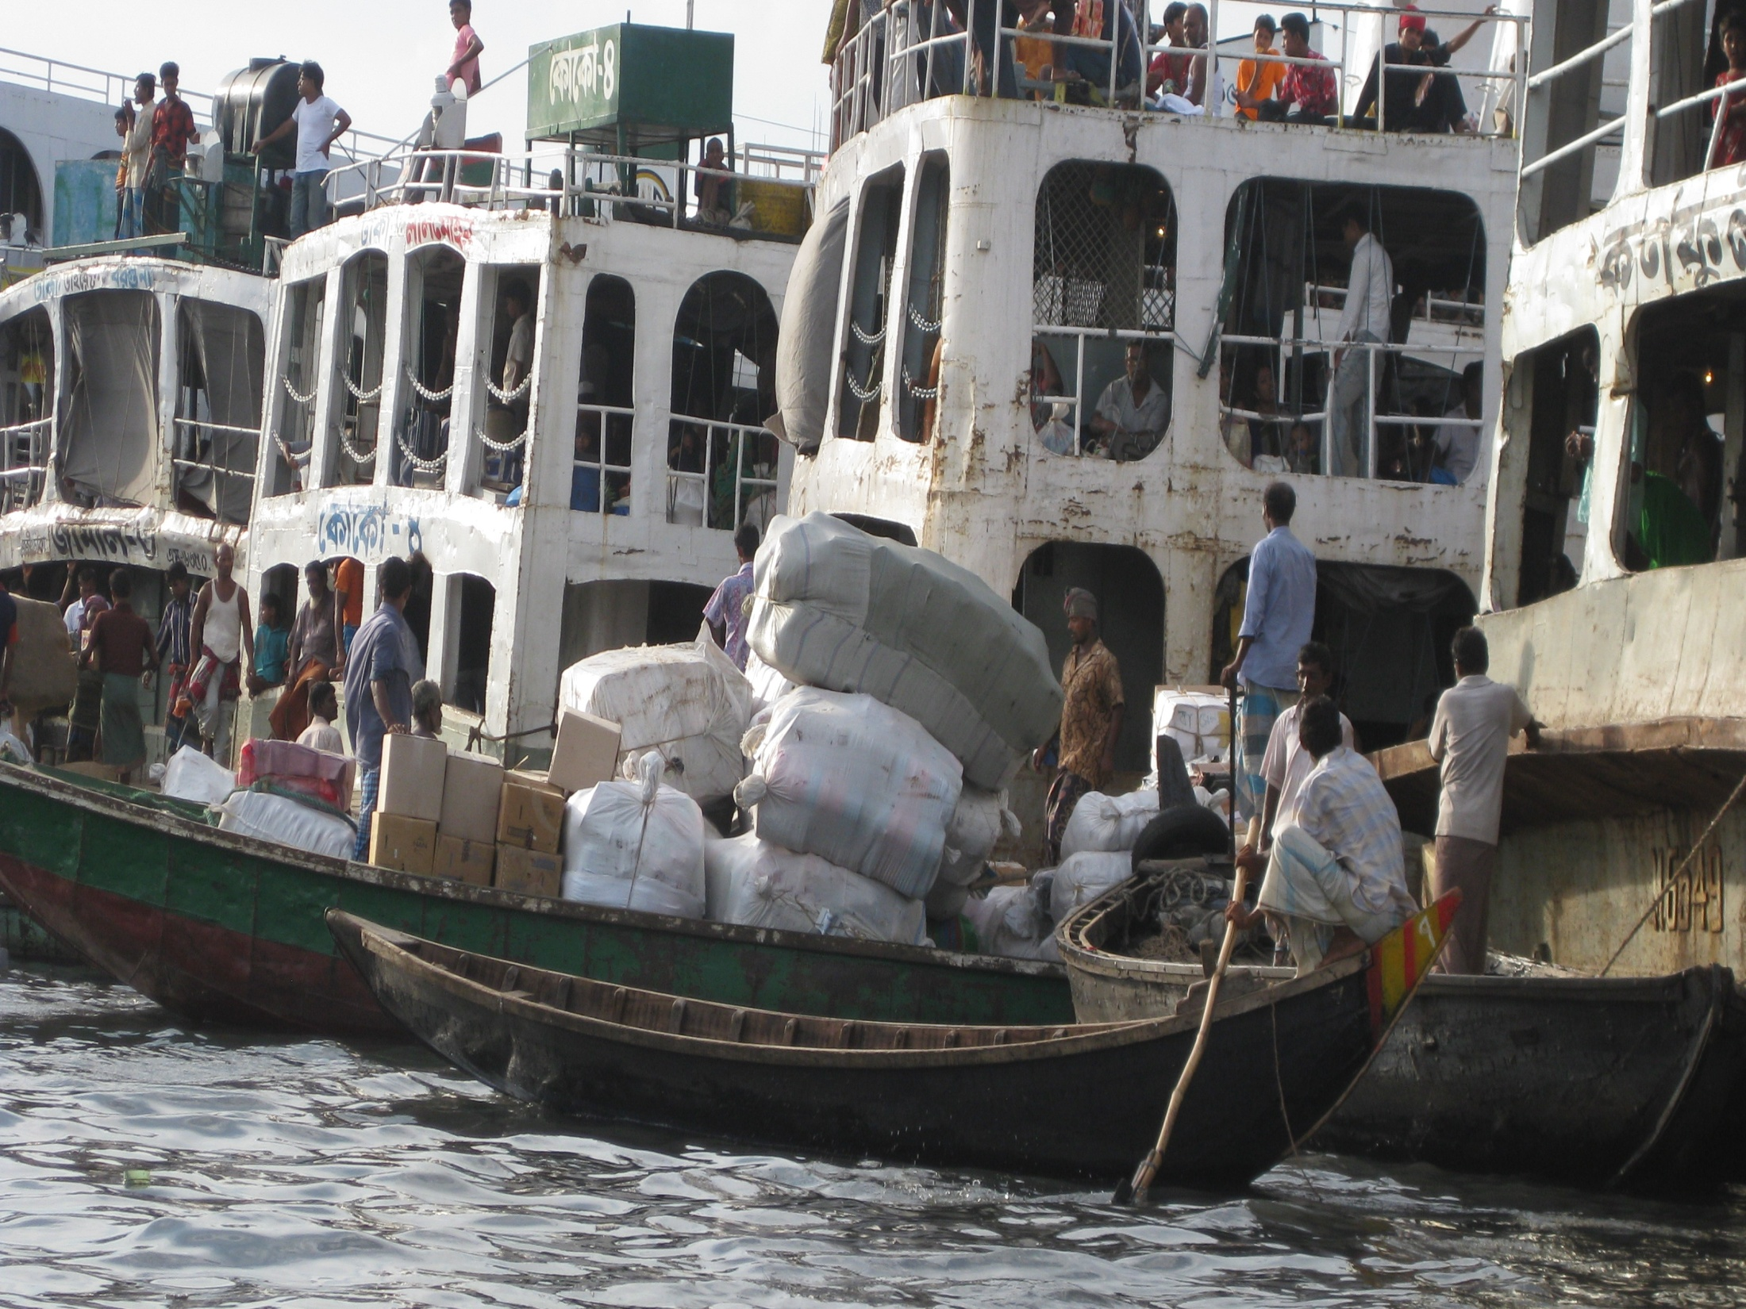

Slide 34
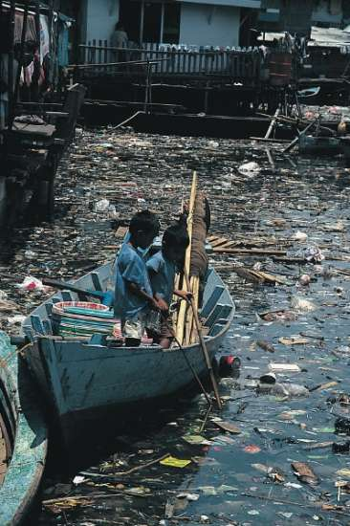

Slide 35
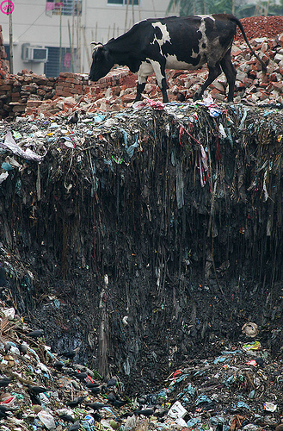

Slide 36
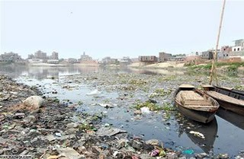

Slide 37
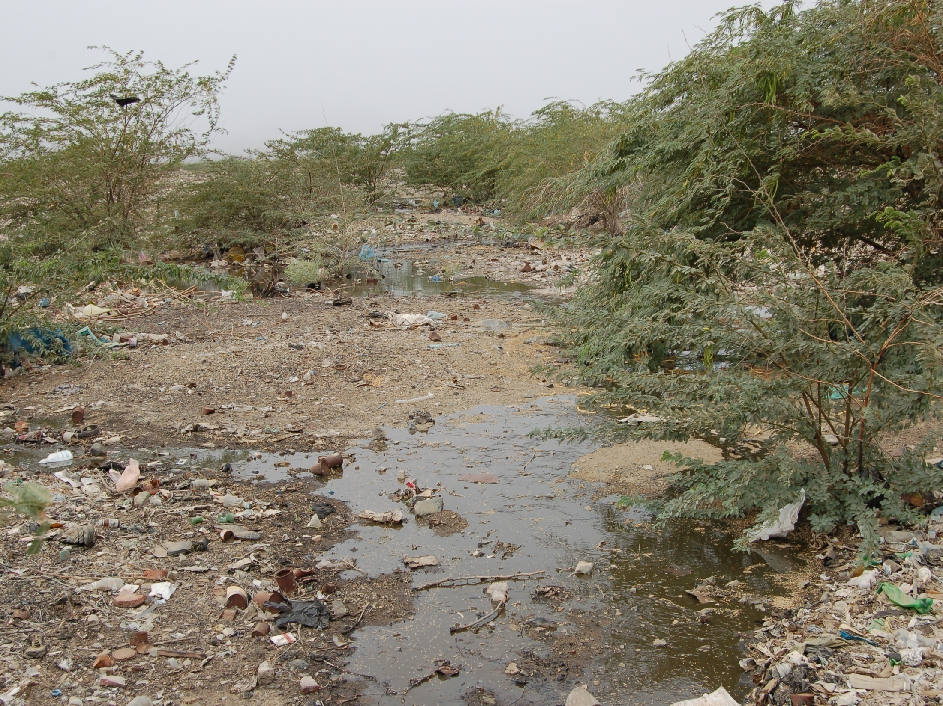

Slide 38
Water pollution
Common pollutants of area rivers, streams, bayous, lakes, ponds, estuaries and bays include:
fertilizers from home lawns and gardens, as well as agriculture;
mercury from power plants and industrial waste;
herbicides and insecticides;
oil and other chemicals from roadway runoff;

Slide 39
Water pollution
prescription medications, paint and other toxic substances disposed down household sinks and toilets;
and sediment from construction sites;
pet waste;
faulty septic systems;
run-off from industrial sources or sewage treatment plants; and
hormone and prescription medications in human waste.

Slide 40
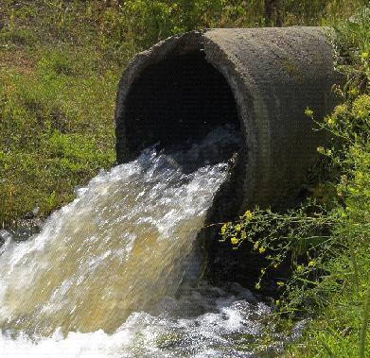

Slide 41
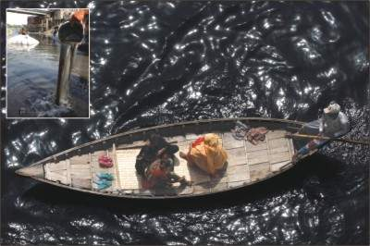

Slide 42
Health risks associated with water pollution
Drinking or washing with contaminated water;
Eating seafood from polluted rivers or bays;
Eating crops watered with polluted water; and/or
Swimming in polluted waterways.

Slide 43
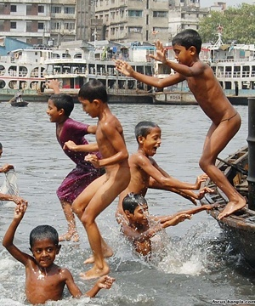

Slide 44
Food Borne hazards
Biological Contamination
Associated with poor domestic sanitation and hygiene arrangements
Chemical Contamination
E.g. food additives, pesticides

Slide 45
Impacts on Atmosphere
Out Door Pollution /Air
Increasing problem in many urban areas due to road traffic;
Also associated with old, heavy and manufacturing industries and mining wind-blown dust also a significant problem in some areas

Slide 46
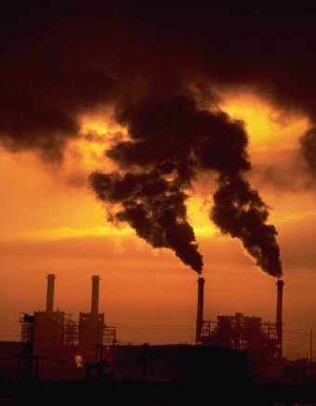

Slide 47
Outdoor pollution- sources
Industry
Vehicles: Cars and trucks
Other sources such as gasoline stations, farm equipments, fires, and outdoor pesticide use.

Slide 48
Infrastructural Impacts
Traffic : Accidents and noise pollution, Growing problem in major cities
Industrial Accidents: Associated mainly with poorly regulated chemical industries
Contaminated land: Old industrial sites and waste-dumps

Slide 49
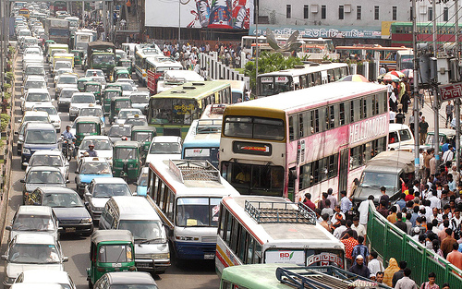

Slide 50
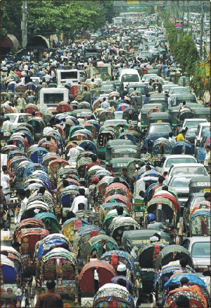

Slide 51

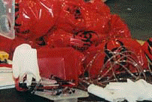
Hazards from Waste
Municipal solid waste includes residential and industrial waste. Solid waste is usually disposed of in landfills or recycled
Hazardous waste, defined as that which is toxic, corrosive, flammable, or ignitable needs to be disposed of properly.
Nuclear waste raise concerns about potential radiation exposure.
Sources are commercial power plants, hospitals, and non-military sources nuclear power plants

Slide 52
Overview
Introduction
  Definition of climate change
What is happening and who is at risk?
Human Impacts on Climate
  Green House Gasses
  Water pollutions
  Food and Agriculture
  Air pollutions
  Waste disposals
  Infrastructural
Climatic Impact on Human Health
  Bio-diversity
    Water and land
    Air
    Vector
Plan of Management
  Mitigation
  Adaptation
Conclusion

Slide 53
Climatic Impact on Human Health
Water and land related hazards
Atmospheric hazards
Vector Borne hazards

Slide 54
Land and climate related hazards
Floods : Common in both lowland coastal and inland areas, especially in Tropics and monsoon areas
Storms and Hurricanes
Volcanic activity
Earthquakes
Soil erosion
Drought

Slide 55
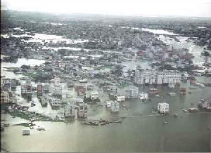

Slide 56
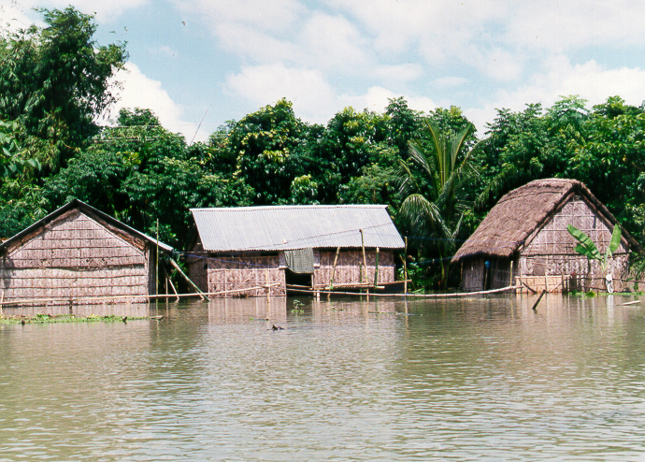

Slide 57
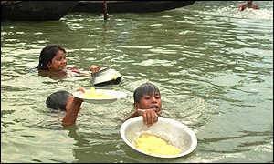

Slide 58
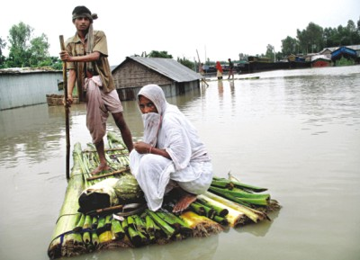

Slide 59
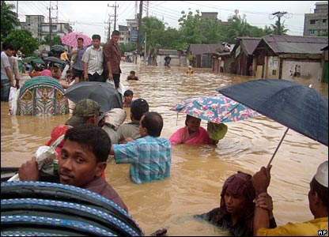

Slide 60
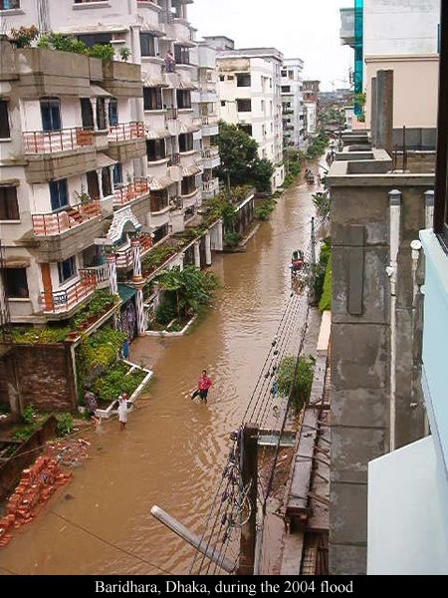

Slide 61
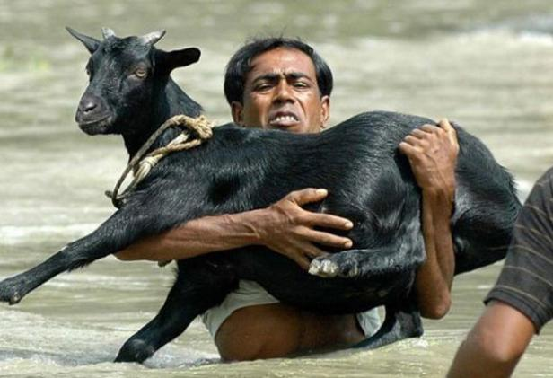

Slide 62
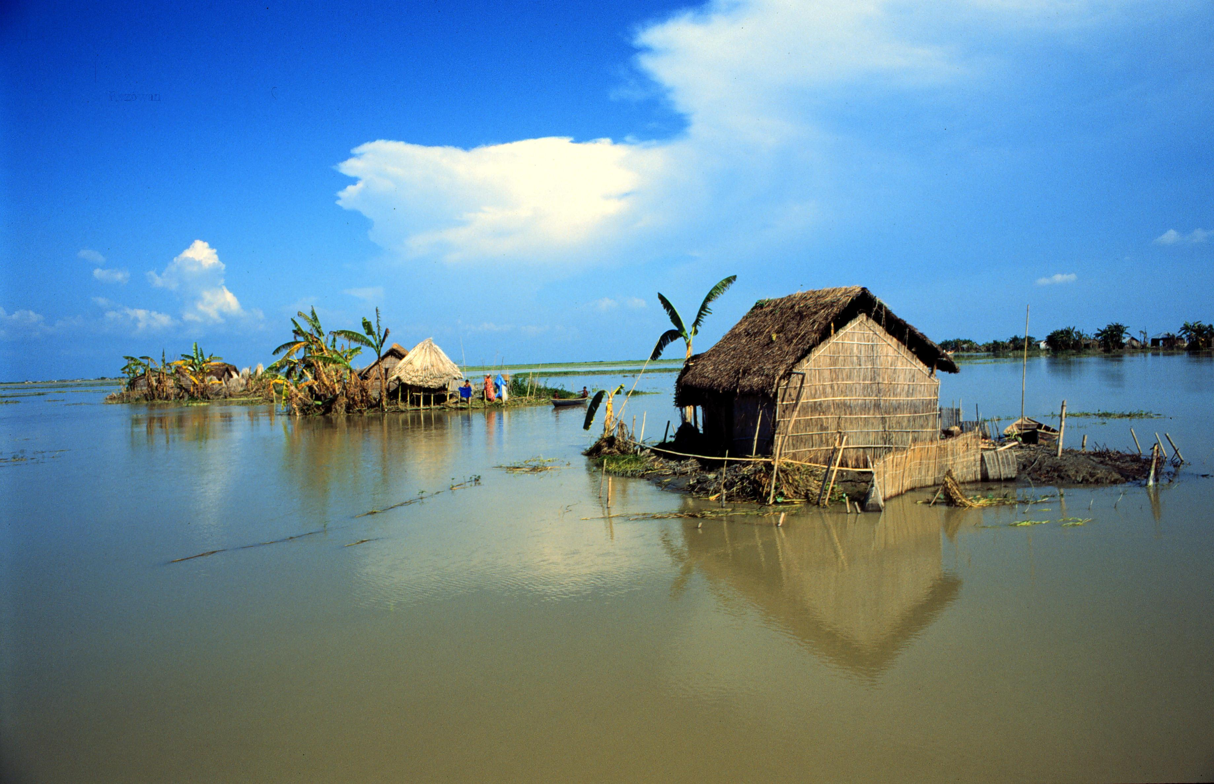

Slide 63
Health Impacts of Floods
Immediate deaths and injuries
Nonspecific increases in mortality
Exposure to toxic substances
Mental health effects
  Anxiety
  Depression
Increased demands on health systems
Notes:
Flooding results in more than immediate deaths and injuries, as listed on this slide.

Slide 64
Health Impacts of Floods
Infectious diseases –
  Diarrheal diseases,
  Respiratory diseases
  Enteric fever
  Hepatitis
  Vector-borne diseases
  Leptospirosis
Snake Bite and others
Notes:
Flooding results in more than immediate deaths and injuries, as listed on this slide.

Slide 65
Health impacts of flooding - acute
Chemical & biological
  Release of pathogens from sewage treatment works
Vulnerable groups
  Old, families with young children & infants, those with existing health problems
Disruption to water and power supplies
    Access to clean drinking water
    Feeding bottle-fed babies
    Hygiene issues
    Clean-up
    Access to food (fridge and freezers?)
    Contamination of food in the home
    Summer vs winter flooding – cold

Slide 66
Health impacts of flooding – medium-term
Waste management
Displacement and migration
Environmental concerns
  Safety of allotment-grown food after a flood

Slide 67
Health impacts of flooding – long-term
Increase in all-cause mortality (Bristol study)
Health effects of damp housing
  Mould
  Respiratory illness
Psychosocial
  Anxiety, stress, depression, relationship problems, displacement of communities and families

Slide 68
Water and Food-borne Disease:
Climate-Susceptible Pathogens
 | Rising temperatures | Increasing rainfall | Shifts in reservoir ranges | Sea level changes
Salmonella | X | X | X
Campylobacter | X | X | X
Vibrio | X | X |  | X
Leptospira | X | X
Enteroviruses | X | X
Naergleria fowleri | X
Cryptosporidium | X | X
Giardia | X | X

Slide 69
Water
Climate change impacts
Water shortages and standpipe use can lead to increased infections as hygiene more difficult to maintain.
Risks from increased consumption of bottled water in warm weather are contamination, multiplication during storage and re-use of containers.

Slide 70
Water supply
Climate change impacts
Upland sources in peat-covered catchments would contain higher levels of dissolved organic carbon, risking trihalomethane formation on disinfection with chlorine
Severe flooding has the potential to significantly affect drinking water supplies through contamination of the mains supply.
At risk are poorly treated private water supplies, unfiltered surface water and groundwater
Notes:
Trihalomethanes (THM) can occur in chlorinated water as a result of reaction between organic materials in the water and chlorine added as a disinfectant. THMs became a public health concern due to their carcinogenic nature.

Slide 71
Food
Climate change impacts
A strong correlation exists between notified food poisoning, Salmonella infections and temperature in the UK.
Higher temperatures increase the rate of infection in animals and multiply bacteria in animal feed.
They increase risk from food prepared and cooked at home, whether through inappropriate food storage and temperature control or increased outdoor cooking and eating (barbecues).
Climate change could cause about 10,000 extra cases of food poisoning a year in the UK¹.
Greater public awareness and food safety training is required.
Notes:
¹Cooking up a Storm, Tara Garnett, Centre for Environmental Strategy, University of Surrey, 2008. Prof. G. Bentham, Centre for Environmental Risk, University of East Anglia). http://www.fcrn.org.uk/frcnResearch/publications/PDFs/CuaS_web.pdf
Dealing with food safety provides opportunities for EHPs to promote sustainable diet and sustainable procurement through interaction with catering and food industries.
Three quarters of the sewer blockages are caused by the build-up of fats, oils and greases (FOG) put down the sink by catering establishments, factories or homes. Anglia Water with the local EHPs is encouraging all it customers to take used cooking oil to a recycling centre across the region. There are now a number of recycling centres who collect waste cooking oil. Schemes have been launched in Norfolk & Suffolk and the used cooking oil is collected by Living Fuels. This helps with both adaptation and reduces the waste going to landfill.

Slide 72
Land and climate related hazards
Floods : Common in both lowland coastal and inland areas, especially in Tropics and monsoon areas
Storms and Hurricanes
Volcanic activity
Earthquakes
Soil erosion
Drought

Slide 73
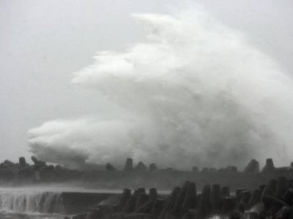

Slide 74
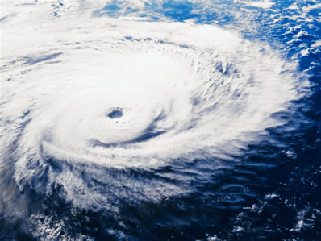

Slide 75
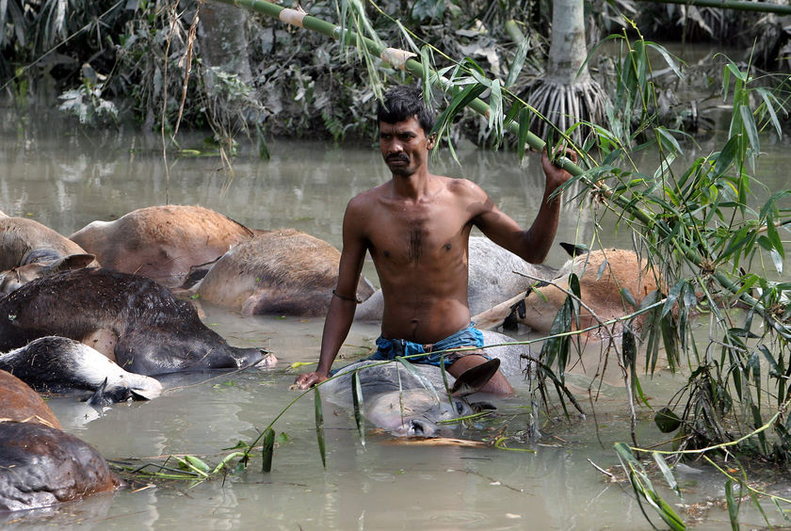

Slide 76
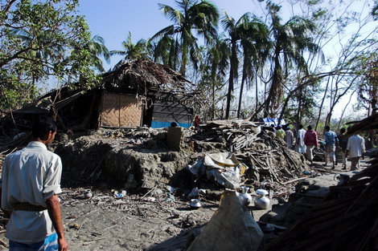

Slide 77
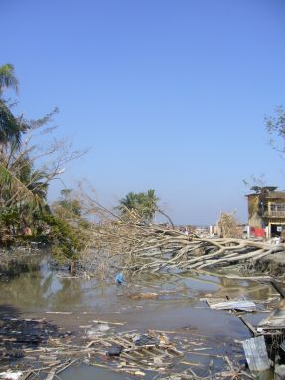

Slide 78
Land and climate related hazards
Floods : Common in both lowland coastal and inland areas, especially in Tropics and monsoon areas
Storms and Hurricanes
Volcanic activity
Earthquakes
Soil erosion
Drought

Slide 79
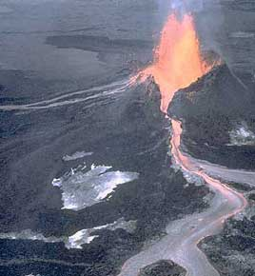

Slide 80
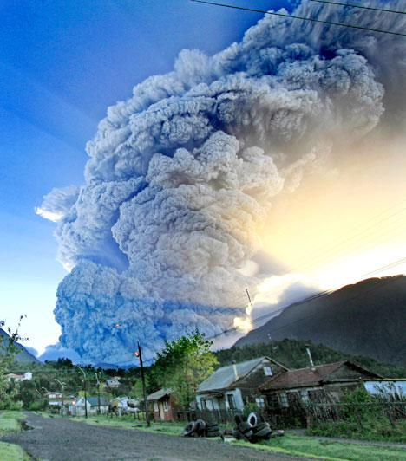

Slide 81
Land and climate related hazards
Floods : Common in both lowland coastal and inland areas, especially in Tropics and monsoon areas
Storms and Hurricanes
Volcanic activity
Earthquakes
Soil erosion
Drought

Slide 82
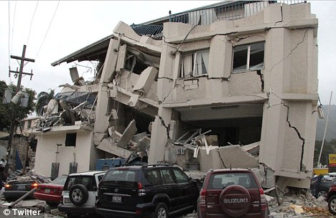

Slide 83
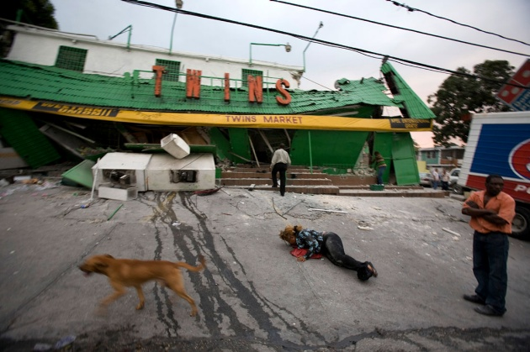

Slide 84
Land and climate related hazards
Floods : Common in both lowland coastal and inland areas, especially in Tropics and monsoon areas
Storms and Hurricanes
Volcanic activity
Earthquakes
Soil erosion
Drought

Slide 85
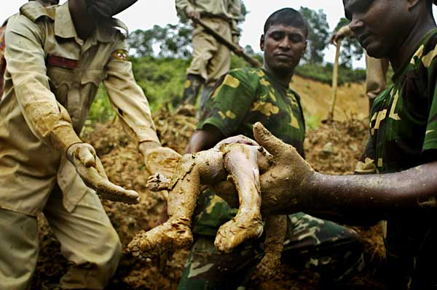

Slide 86
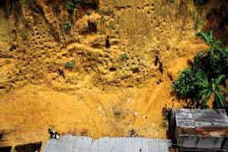

Slide 87
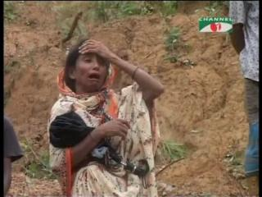

Slide 88
Land and climate related hazards
Floods : Common in both lowland coastal and inland areas, especially in Tropics and monsoon areas
Storms and Hurricanes
Volcanic activity
Earthquakes
Soil erosion
Drought

Slide 89
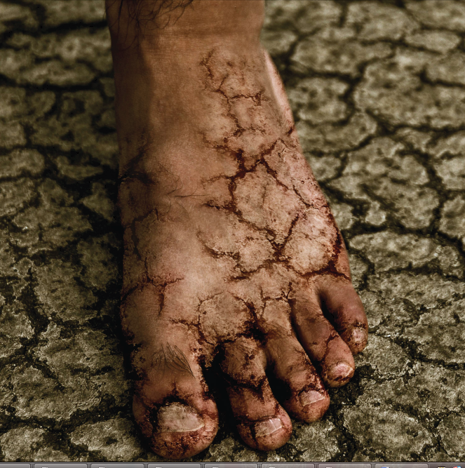

Slide 90
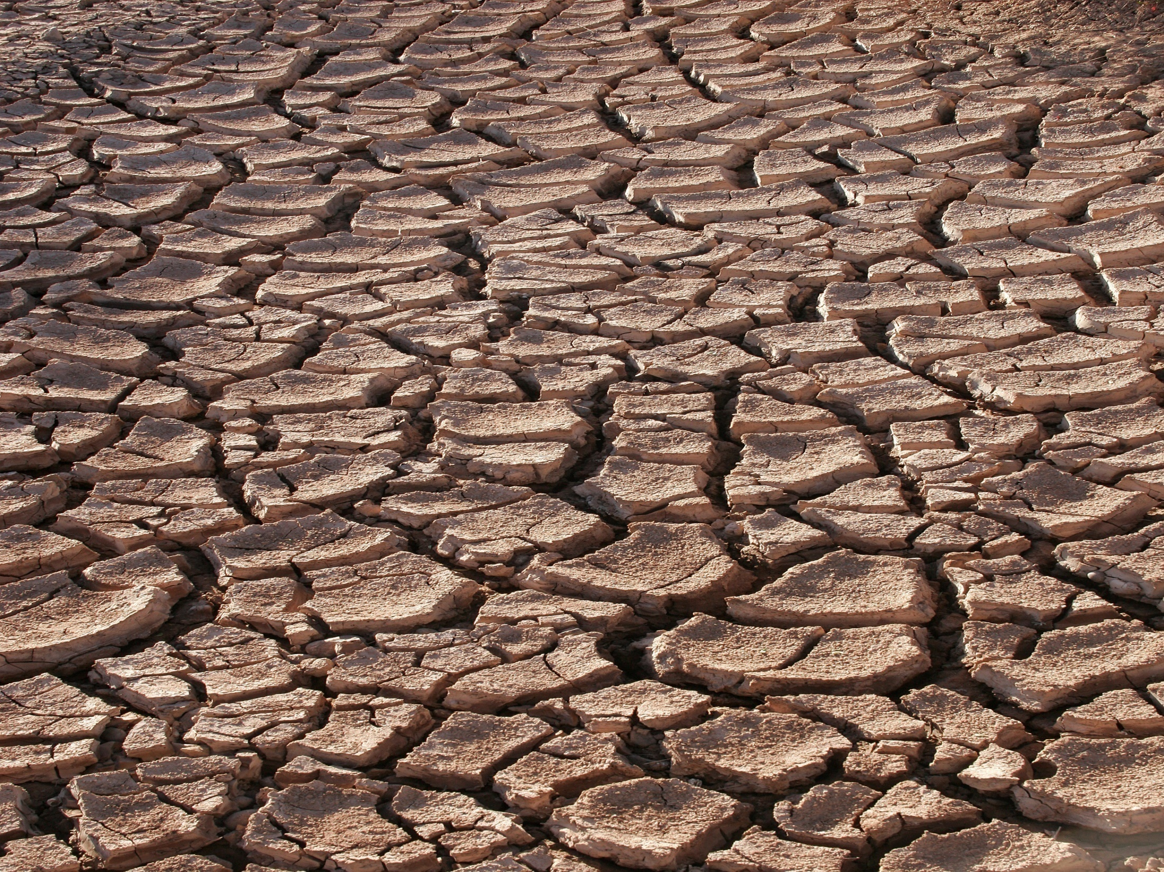

Slide 91
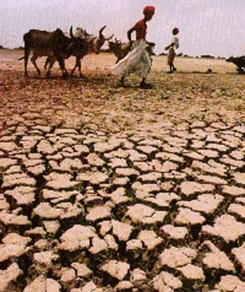

Slide 92
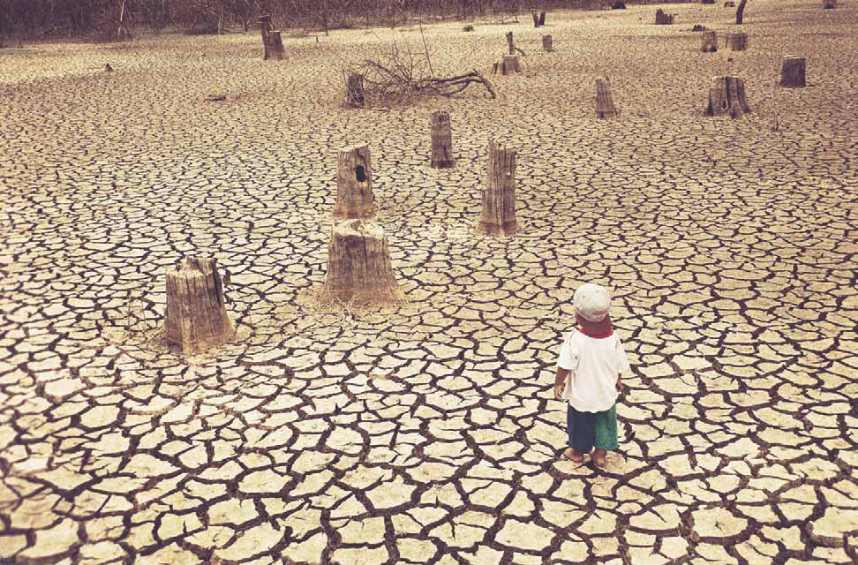

Slide 94
Lung health and climate change
Diseases
Asthma
Rhinitis and allergies
COPD
Respiratory infections
Lung cancer
Comorbidities
Environmental factors
Air pollution
Extreme summer events
Extreme winter events
Thunderstorms
Allergens

Slide 95

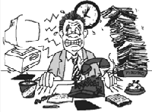
Other Environmental Health Hazards
Heat and Humidity
High humidity impedes the body's ability to cool itself.
This is a particular problem for the elderly.
Stress
Excessive stress is associated with decreased immune function and an increased risk of climatic change related illness.

Slide 96
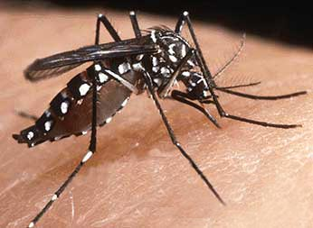
VECTOR-BORNE DISEASE

Slide 97
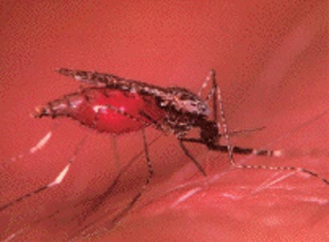
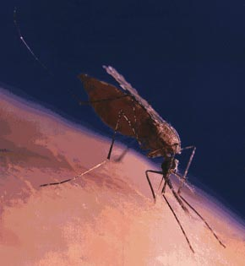

Slide 98
Vector Borne Hazards
Water related vectors
  E.g. malaria, dengue
Animal related vectors
  E.g. sleeping sickness, bubonic plague
Others
  Kala-Azar, Filariasis

Slide 99
Vector-Borne Diseases
Many parts of complex systems are climate sensitive
  vector survival, reproduction, development, biting rates
  pathogen reproduction, development
Disease activity depends on multiple factors and is region specific
  lifestyle, vector control measures, medical care
Vigilance needed for imported diseases
  Greatest threat remains foreign travel, border areas

Slide 100
Relationship of Temp. & RH with Malaria Parasite and Mosquito Development
10 11 12 13
Minimum temp. for
parasite development
Optimum
temp.
Maximum temp.
for mosquito
survival
14 15 16 17 18 19
25 26 27
40 ºC
Relative Humidity 40 60 70 80
Minimum Temp. required for transmission
P vivax: 14.5-16 C P falciparum:16-18 C

Slide 101
Relationship between Temperature and Time Required for Parasite Development
Notes:
This graph shows the number of days required for malaria parasite development as a function of mean temperature. At mean temperatures less than 21°C, mosquitoes have to survive at least 20 days after they acquire the malaria parasite to be infective. As mean temperature rises to about 21°C, the time required becomes shorter. At 30°C, it takes just a few days for mosquitoes to become infective.

Slide 102
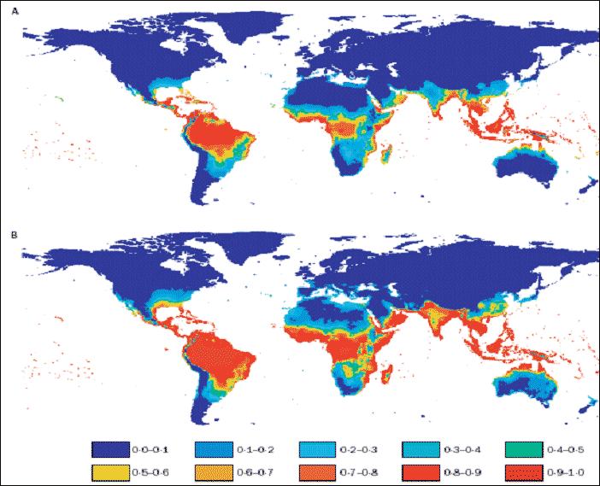
Estimated population at risk of dengue fever under “standard” climate change scenario: 1990, 2085
1990
2085
.
Source. Hales S et al. Lancet (online) 6 August 2002. http://image.thelancet.com/extras/01art11175web.pdf

Slide 103
The Health Issues in Bangladesh

Slide 104
Factors Increasing Bangladesh’s Vulnerability to Climate Change
Geography
Most elevations under 10m
Climate
Subject to severe natural disasters
Population
1998 population 126 million. High growth rate and population density
Economy
One of the world’s poorest nations. 1999 GNP/capita: $370
Education
Literacy rate of 53%
Human Health
Life expectancy: 58 years. 56% under 5 malnourished

Slide 105
Population Estimates for 2025 in Southeast Asia
Country | 2025 (thousands) | % of world population
Bangladesh | 206,024 | 2,6
Bhutan | 819 | 0,01
Democratic People's Republic of Korea | 25,228 | 0,3
India | 1,447,499 | 18,5
Indonesia | 271,227 | 3,4
Maldives | 411 | 0,005
Myanmar | 55,374 | 0,7
Nepal | 38,855 | 0,5
Sri Lanka | 20,328 | 0,3
Thailand | 68,803 | 0,9
Timor-Leste | 2,011 | 0,03
SEA total | 2,136,579 | 27,1
UN Department of Economic and Social Affairs, 2009
Notes:
While only occupying 5% of the earth’s surface, the Region’s population was estimated at 1,696,550,000 in 2005, 26% of the world’s population. Projections for 2025 estimate the number of population in SEA to grow up to 2.14 billion (UN Department of Economic and Social Affairs, 2009).
A significant proportion of the SEA population does not have access to health services and does not receive quality health care, leading to unnecessary morbidity and mortality, not only in remote areas and among vulnerable populations but also in hospitals. There is limited coverage by various health insurance schemes in many countries of the Region, resulting in high out-of-pocket costs. The Region has an acute shortage of trained health workers, including a community-based workforce, which can play an effective role in empowering the community.

Slide 106
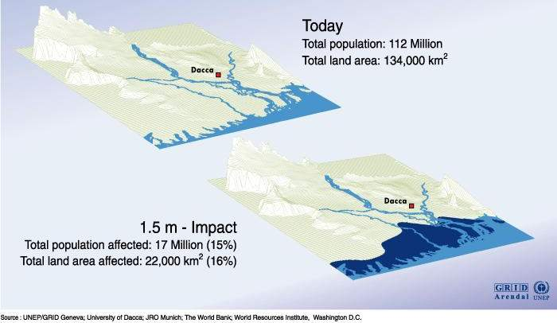
Sea Level Rise: Bangladesh
Notes:
Global warming will also affect sea temperatures. Increased frequency of El Niño events and future changes in ocean currents, sea level, sea-water temperature, salinity, wind speed and direction, strength of upwelling, the mixing layer thickness, and predator response to climate change have the potential to substantially alter fish breeding habitats and food supply for fish and ultimately the abundance of fish populations in Asian waters (IPCC, 2001).
Rising sea levels increase the risk of coastal flooding, and may lead to displacements of population. The most vulnerable areas in the SEA region are the Ganges-Brahmaputra delta in Bangladesh, and all the small islands – in the Maldives, Indonesia – as well as the entire coastline of the Indian Ocean.
Mainly due to the expansion of the warmer sea water, sea levels will rise steadily in the Region, even if greenhouse gas concentrations are stabilized. Sea level rise increases the risk of river floods and high population densities. The risk of flooding in mega deltas is highest. Indeed, IPCC states that “Coastal areas, especially the heavily-populated megadeltas regions in South, East and South East Asia, will be at greatest risk due to increased flooding from the sea and, in some megadeltas, flooding from the rivers” (IPCC, 2007b).
In addition, warmer sea surface temperatures could also increase the frequency and/or intensity of cyclones in the Indian Ocean region.
According to the IPCC, coastal ecosystems could be destroyed (wetlands, mangroves, coral reefs) with an increased coral bleaching, leading to widespread coral mortality due to temperature increases of 1-3°C. Indeed, small islands are under threat of sea level rise and would be affected by storm surges and cyclones before they face actual submersion.

Slide 107
Incidence of major climate sensitive diseases in Bangladesh
Period | Diseases | Incidences
 |  | Total | Average/year
1988-2005 | Diarrhoea | 48302636 | 2842273
1988-1996 | Skin diseases | 23697833 | 2623092
1974-2004 | Malaria | 1018671 | 33956
1994-1999 | Kala-azar | 38169 | 6361
1988-1996 | Mental disorder | 201881 | 22431
1999-2005 | Dengue | 19830 | 3305
Sources: SEARO-WHO, 2006; DG-Health, 1996; BBS, 2005

Slide 108
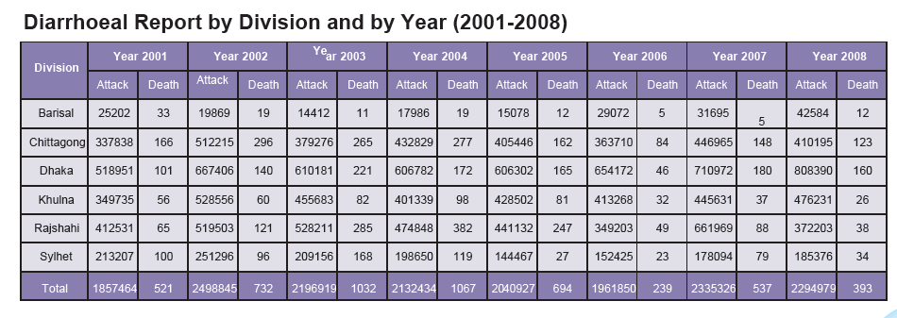

Slide 109
Malaria trend in Bangladesh
Source: Climate Change Cell Report, Bangladesh

Slide 112
ARI

Slide 113
Kala-azar (visceral leishmaniasis, VL)
2009

Slide 114
Dengue

Slide 115


Slide 116


Slide 117


Slide 118


Slide 119


Slide 120
Urban Air Pollution
Dhaka alone experiences about 3,580 premature deaths every year due to air pollution.
Air pollution causes around 15000 deaths per annum,
one million to suffer from major diseases and over 8.5 million with minor diseases in four major cities including Dhaka.
-MIS-DGHS

Slide 121
Climate (Climatic zones, recent trends in temp, precipitation)
Results of the study Climate Change and Health Impacts in Bangladesh
Rajshahi- Drought
Manikganj-Flood
Satkhira- Coastal Flood, salinity, Sea level rise

Slide 122
Major diseases encountered in Flood 2007

Slide 123
Health outcomes in landslide 2007

Slide 124

SIDR
Severely affected districts | 9
Total affected districts | 31
Severely affected upazillas (sub districts) | 57
Total affected upazillas | 93
Crops destroyed in 11 costal districts | 95%
Population affected | 8.5 million
Houses destroyed | 564,000 completely 885,280 partially
Total injured | 40000
Total deaths | 3292

Slide 126


Slide 127

Articles indexed in Pubmed referring to “health”
and either “climate change” or “global warming”

Slide 128

It affects our largest global health problems
Each year:
- Under nutrition kills 3.5 million
- Diarrhoea kills 2.2 million
- Malaria kills 900,000
- Extreme weather events kill 60,000
These, and others, are highly sensitive to temperature and precipitation.
US CDC

Slide 129
Estimated Death and DALYs Attributable to Climate Change
2000
Floods
2020
Malaria
Diarrhea
Malnutrition
120
100
80
60
40
20
0
2
4
6
8
10
Deaths (thousands)
DALYs (millions)
Campbell-Lendrum et al., 2003
Notes:
This shows the total burden of disease attributable to climate change in 2000 and 2020 for floods, malaria, diarrhea, and malnutrition. The left hand side of the graph shows the results in thousands of deaths, and the right shows the results in millions of disability-adjusted life years lost. Most of the disease burden is due to diarrheal diseases and malnutrition.

Slide 130
Overview
Introduction
  Definition of climate change
What is happening and who is at risk?
Human Impacts on Climate
  Green House Gasses
  Water pollutions
  Food and Agriculture
  Air pollutions
  Waste disposals
  Infrastructural
Climatic Impact on Human Health
  Bio-diversity
    Water and land
    Air
    Vector
Plan of Management
  Mitigation
  Adaptation
Conclusion

Slide 131
What Should We Do?
Mitigation = reduce GHG emissions
  Reduce energy usage and Reduce, Reuse, Recycle
    As individuals, at home
    As organizations, at work
Adaptation = prepare for impact of climate change
  Emergency preparedness
    As individuals/families
    As local health department
Notes:
There are two basic categories of response to climate change: adaptation is analogous to preparedness – how can we lessen the impact of climate change - for example by building sea walls to protect against sea level rise, or ensuring we have cooling centers for heat waves. Mitigation means primary and secondary prevention – what can we do now to slow or reverse climate change, by reducing the level of greenhouse gases in the atmosphere so that we can avert the worst climate change scenarios? Clearly, both adaptation and mitigation are vitally important. Adaptation because climate change is already upon us, and more is in the pipeline, so we must enhance our preparedness and response capability. Mitigation because unless we act now, the magnitude of climate change will surely overwhelm our adaptive capacity, with dire consequences for human health on a global scale.

Slide 132
What Should We Do?
Mitigation and adaptation = advocate for healthy policies
  Support legislation that reduces GHG emissions
  Support sustainable lifestyles & communities
Notes:
There are two basic categories of response to climate change: adaptation is analogous to preparedness – how can we lessen the impact of climate change - for example by building sea walls to protect against sea level rise, or ensuring we have cooling centers for heat waves. Mitigation means primary and secondary prevention – what can we do now to slow or reverse climate change, by reducing the level of greenhouse gases in the atmosphere so that we can avert the worst climate change scenarios? Clearly, both adaptation and mitigation are vitally important. Adaptation because climate change is already upon us, and more is in the pipeline, so we must enhance our preparedness and response capability. Mitigation because unless we act now, the magnitude of climate change will surely overwhelm our adaptive capacity, with dire consequences for human health on a global scale.

Slide 133
Why Should Public Health Care?
It is our job to protect the public’s health
  WHO estimates that in the year 2000, there were 150,000 excess deaths per year due to climate change
  Climate change is already affecting health around the world, and its impact on health will continue to grow
Fighting climate change is aligned with protecting and promoting health

Slide 134
Why Should Public Health Care?
  Many of the proposed solutions for climate change are healthy for everyone
We have the appropriate skills
  Public Health has the skills to effect behavior change, and those skills can help people adopt greener behaviors too
  Public Health has policy and advocacy skills that will help encourage organizational and societal changes
We can be role models because we have lots of experiences.

Slide 135
Notes:
The challenges of addressing climate change are tremendous. The threat is frightening. The science is complex and technical; there’s been prolonged active dissemination of misinformation which has slowed our movement to act. Addressing the problem will require significant behavioral and controversial policy changes. But aren’t those typical challenges in public health? Howie Frumkin from CDC describes how the ten essential functions of public health can be applied to climate change. But the reality is that public health in the U.S. hasn’t fully engaged on this issue. Two recent surveys of local health officers indicate that, while we understand that climate change is important, we feel ill prepared to address it. To date, our focus has been on adaptation – heat response plans, or expansion of vector surveillance. These adaptation strategies are critically important. But they are not sufficient. We must step up our involvement now, and embrace our very important role as partners with those who are trying to engage the public, industry, and policy-makers in supporting urgent and substantive action to mitigate climate change

Slide 136
Key Mitigation Technologies & Practices
Transport
  Fuel efficiency
  Hybrids
  Road to rail
  Public transport
  Non-motorized transport
  Land-use planning
Buildings
  Day lighting
  Energy efficiency
  Improved cook stoves
  Solar heating & cooling
Agriculture
  Crop & land management
  Livestock & manure management
  Use of Natural fertilizer Industry
  Energy efficiency
  Heat & power recovery
Energy supply
  Coal to gas
  Nuclear power
  Renewable energy
Notes:
There are hundreds of different ways to mitigate climate change, many of which are already commercially available and feasible. A lot of these available mitigation strategies - the green ones on this list, for example, have health co-benefits. .

Slide 137
Climate & Health Co-benefits of Decreased Auto Use
Reductions
Greenhouse gas emissions
Air pollution
Noise
Infrastructure costs
Community Severance
Increases
Physical Activity
Social Capital
Reductions
Respiratory disease
Traffic injuries
Heart disease
Depression
Osteoporosis
Diabetes
Cancer
Stress
Notes:
So in summary, we can see that increased fuel efficiency and decreased auto use – through a variety of land use, transportation policies, fuel efficiency measures - results not only in decreased greenhouse gas emissions, air pollution, noise, infrastructure costs, and community severance but also increases physical activity , reduces obesity, respiratory disease, traffic injuries, heart disease, depression, osteoporosis, diabetes, cancer, and stress, and increases social capital.

Slide 138
Lifestyle change
Reductions in:
Inactivity (~1.9 million deaths per year worldwide)
Injuries (~1.2 million deaths per year)
Animal product intake in high consumption countries (Coronary Heart Disease deaths etc)

Slide 139
The health co-benefits of climate change mitigation policies
Technologies to reduce GHG emissions and outdoor air pollution (~0.8 million deaths p.a. in urban areas)
Improved energy efficient cookstoves or clean fuels ( 1.6 million deaths p.a. from indoor air pollution)

Slide 140
Mitigation: At Homes
& Workplaces
Establish recycling programs in the workplace and home
  Recycling half of your household waste = hundreds of lbs. of CO₂ saved per year
Promote energy efficiency in the home and workplace
  Changing regular light bulbs to compact fluorescent bulb throughout your house = hundreds of lbs of CO₂/yr
Make “small energy” use changes on a broad scale
  E.g. replacing all light bulbs with energy efficient light bulbs in all County buildings
Encourage renewable energy power sources (solar energy and wind energy) and responsible use of energy
  Turning off your TV, computer, and other electronics = thousands of lbs. of CO₂ saved per year

Slide 141
Mitigation: At Homes
& Workplaces
Try to drive less and walk more!
  You save gas money and keep our air cleaner for every mile you don’t drive
  Most car trips taken in your neighborhood are short enough to walk or bike
Encourage carpooling to work/school
Encourage public transportation use
Provide incentives for employees to purchase fuel-efficient vehicles (e.g. electric, hybrid, CNG vehicles)

Slide 142


Slide 143


Slide 144


Slide 145


Slide 146


Slide 147


Slide 148


Slide 149
Household Energy Emission
New stove technologies have the potential to bring emission of products of incomplete combustion from biomass stoves down nearly to those of clean fuels, such as Liquefied Petroleum Gas ( LPG)
Paul wilkilson et al, Lancet Nov 2009

Slide 150
Urban Land Transport
In UK, two fifth cut in carbon emission benefits for HEALTH , more walking, cycling,& less motor vehicle by:
Reduction of
CAD, Stroke (10-20 % )
Breast Cancer (12 -13 %)
Dementia( 08%) ,
Depression (05% )
Lancet Nov 2009

Slide 151
Agriculture and Food
Agriculture and Food production account for 10-12% of GHG emissions
Four fifth of these emission from Livestock farm.
Health benefits: 30% reduction of consumption of animal fat reduce 15% heart attack, obesity and diet related cancer.
Sharon Friel et al , Lancet Nov 2009

Slide 152
Top ten actions for national and local policy-makers
Advocate for strong and equitable climate change agreements.
Promote the need for «health-oriented» agreements.
Establish multisectoral processes to oversee climate change and health policy development.
Protect the most vulnerable.
Strengthen health system adaptive capacity.

Slide 153
Top ten actions for national and local policy-makers
Take into account health co-benefits when considering different greenhouse gas mitigation options.
Increase funding for interdisciplinary research on climate change mitigation technologies and strategies across a range of sectors.
Measure public awareness and attitudes
Measure and address the ‘carbon footprint’ of your public institutions.
Incentivize your workforce and all stakeholders

Slide 154
What do we still need?
Health to be recognized as the "bottom line" of the response to climate change
Identification of the health sector as a priority for adaptation support from global to local level
Protection and promotion of health as a central criteria for supporting mitigation policies

Slide 155
Adaptation: Emergency Preparedness
We need to prepare now for the inevitable effects of climate change, such as heat waves and wildfires
  Good news: preparing for one type of emergency prepares us for all types of emergencies
  Preparation minimizes impact of disasters and fear/anxiety
We need to prepare ourselves as individuals and as health agencies

Slide 156
Overview
Introduction
  Definition of climate change
What is happening and who is at risk?
Human Impacts on Climate
  Green House Gasses
  Water pollutions
  Food and Agriculture
  Air pollutions
  Waste disposals
  Infrastructural
Climatic Impact on Human Health
  Bio-diversity
    Water and land
    Air
    Vector
Plan of Management
  Mitigation
  Adaptation
Conclusion

Slide 157

Wednesday, 16 September 2009
Climate change will damage your health
World's doctors unite in challenge to politicians over
'biggest health threat of this century'

Slide 158
Policy Implications and call to action
To achieve MDGs & reduction in health inequities
in COP 15 , Dec 2009 health gain mitigation policies have received little attention.
So health professionals are called to reach beyond conventional professional boundaries to collaborate with policy makers and scientist concern with the study, development and implementation of policies and technologies to mitigate climate change

Slide 159
Take home message
The climate change is not just a health related issue, it is a global issue which includes every sectors of our life to be involved.
We don’t have any other options but only one world to live in.
To save the world it is necessary to act right now.
And to act, it is necessary to know, and to be aware of.

Slide 160

Knowing is not enough; we must apply.
Willing is not enough; we must do.
(Goethe)
জানাই যথেষ্ঠ নয়, প্রয়োগ প্রয়োজন
তেমনই শুধু ইচ্ছায় সব হয় না,
আমাদের তা করা জরুরী।

Slide 161

Let’s save the only world we have

Slide 162
Acknowledgement:
Dr. Quazi Tamjidul Islam. (BIRDEM)
Dr Nasreen Khan, Medical officer, MIS- DGHS
Dr Md Mushfiqur Rahman
National Consultant (Epidemiologist) WHO
Dr. Rashidul Haque
Head of Parasitology Laboratory ICDDR,B
Dr. Md. Ariful Bashar. Post- Graduate Student.
Prof. Ali Hossain NIDCH
Dr. Ahmed Sharif NIPSOM
M. Andalib, Serveir, Bangladesh

